Slide 1
Guidelines – PPC2025
8TH EDITION PARIKSHA PE CHARCHA 2025

Slide 2
Important Dates - PPC 2025
8TH EDITION PARIKSHA PE CHARCHA 2025
Start Date - 14th December 2024
End Date - 14th January 2025

Slide 3
About PPC 2025
8TH EDITION PARIKSHA PE CHARCHA 2025

Slide 4
8TH EDITION PARIKSHA PE CHARCHA 2025

Slide 5
8TH EDITION PARIKSHA PE CHARCHA 2025

Slide 6
Login myGOV site or Click on the link: https://innovateindia1.mygov.in/
8TH EDITION PARIKSHA PE CHARCHA 2025

Slide 7
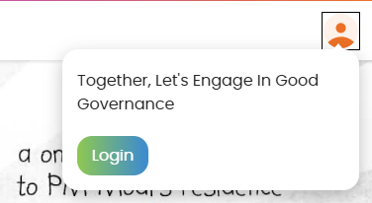
PPC 2025 – Home Page
8TH EDITION PARIKSHA PE CHARCHA 2025

Slide 8
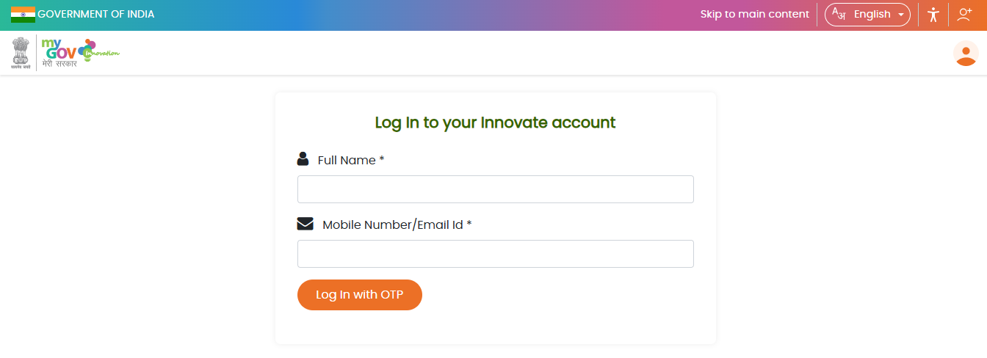
PPC 2025 – Log in
8TH EDITION PARIKSHA PE CHARCHA 2025

Slide 9
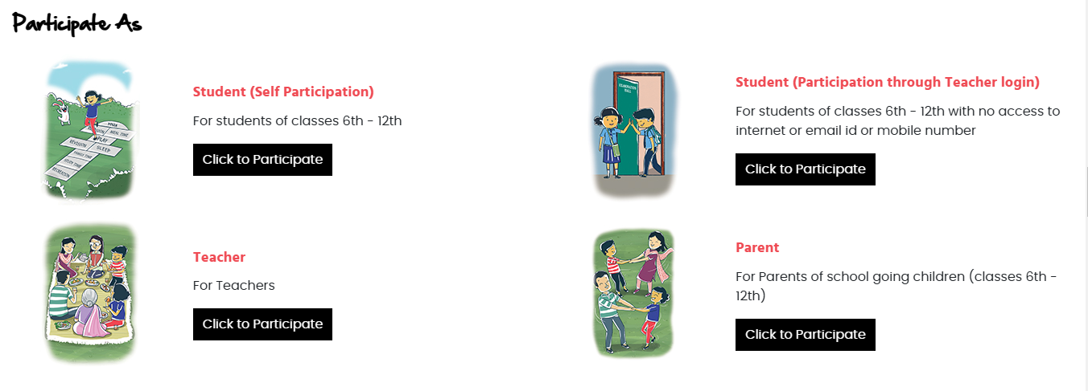
PPC 2025 – Participation Category
8TH EDITION PARIKSHA PE CHARCHA 2025
First things first, click on the ‘Participate Now’ button.
Remember, the competition is open for school students of classes 6 to 12.
Students may also submit their question to the Hon'ble Prime Minister in a maximum of 500 characters.
Parents and teachers can also participate and submit their entries in the online activities designed exclusively for them.

Slide 10
About PPC 2025
8TH EDITION PARIKSHA PE CHARCHA 2025
About 2500 students selected to participate in the main event will receive PPC Kits from the Ministry of Education.

Slide 11
Using of Hashtags (Social Media)
8TH EDITION PARIKSHA PE CHARCHA 2025
#PPC2025
#ExamWarriors

